Slide 2
Structure
Structure 1:
Torch tensors
Regression (scikit-learn & pytorch)
Classification (scikit-learn & pytorch)
NN
Structure 2:
Dataset+scikit-learn
Torch tensors
Regression in PyTorch
Classification in PyTorch
NN

Slide 3
Basic Premise
Machine learning allows us to tackle problems by letting a solution be found organically, rather than engineering a specific algorithm
We don’t give explicit instructions
We feed a model lots of data and let the model work out a solution
Machine learning is like farming
We are now in a position where ML capabilities exceed human ones in a wide variety of tasks

Slide 4
AI vs ML vs DL

Slide 5
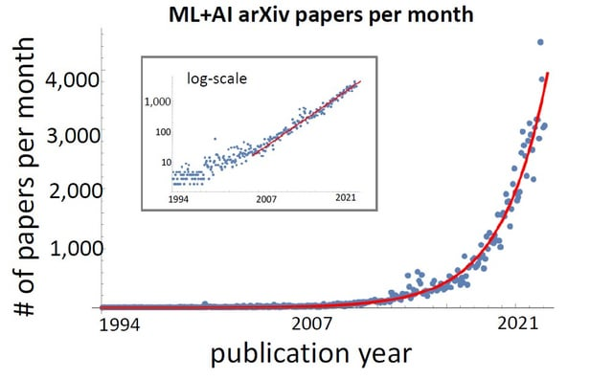
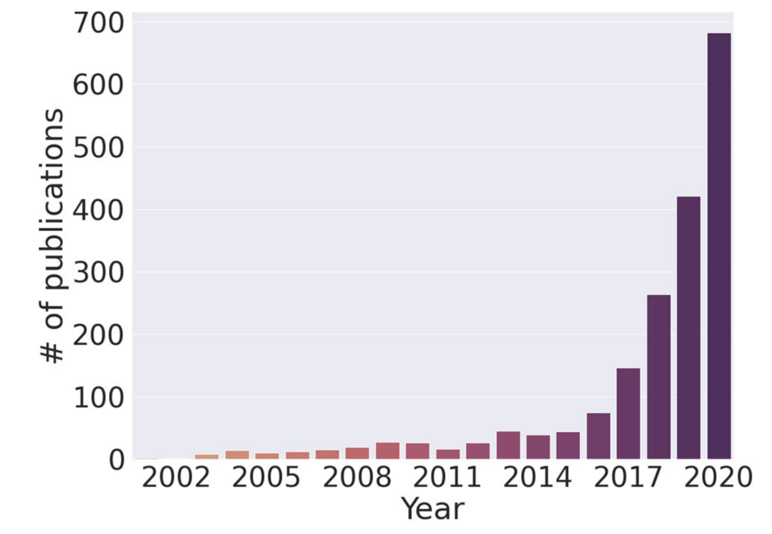
Why ML now?

Slide 6

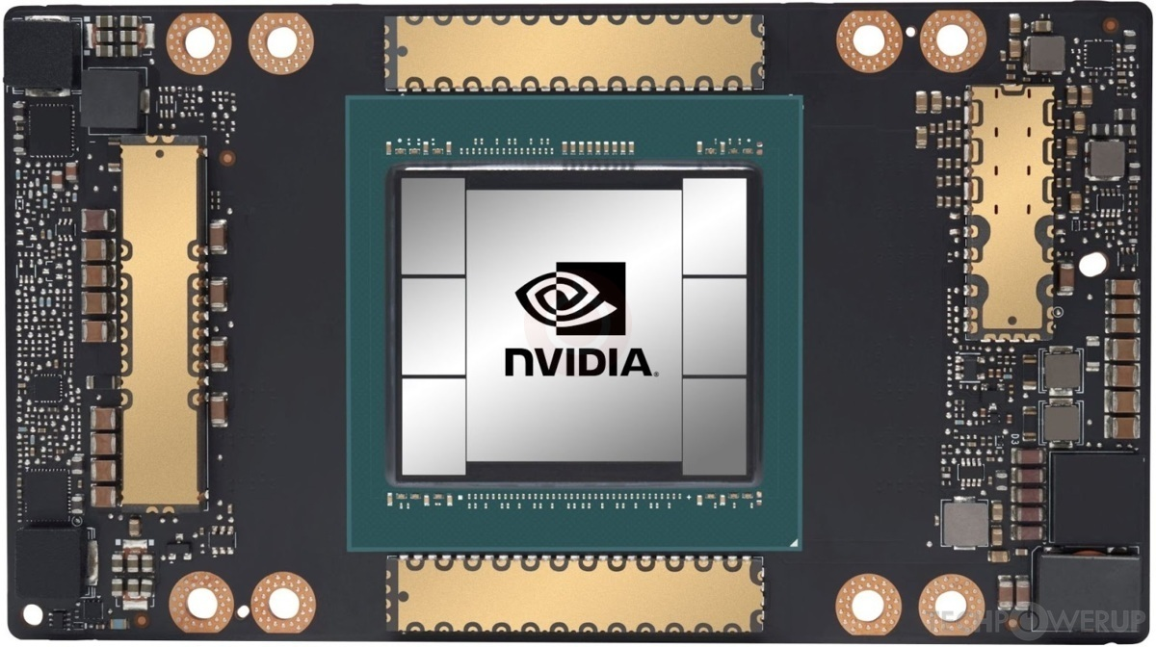
Why ML now?
Access to large datasets
Increased computational power
Breakthroughs in algorithms
Open-source libraries
Companies doing AI
Economic and political motivation

Slide 7
AI Timeline in 21st Century
ImageNet, 2009 – Fei-Fei Li creates dataset
AlexNet, 2012 – Alex Krizhevsk’s model for images uses deep learning (CNN)
Tensorflow, 2015 – Made open-source
AlphaGo, 2016 – Beats Lee Sidol 4-1
Transformer, 2017 – “Attention is all you need”
AlphaFold2, 2020 – Wins CASP competition
ChatGPT, 2022 – Commercial LLM

Slide 8
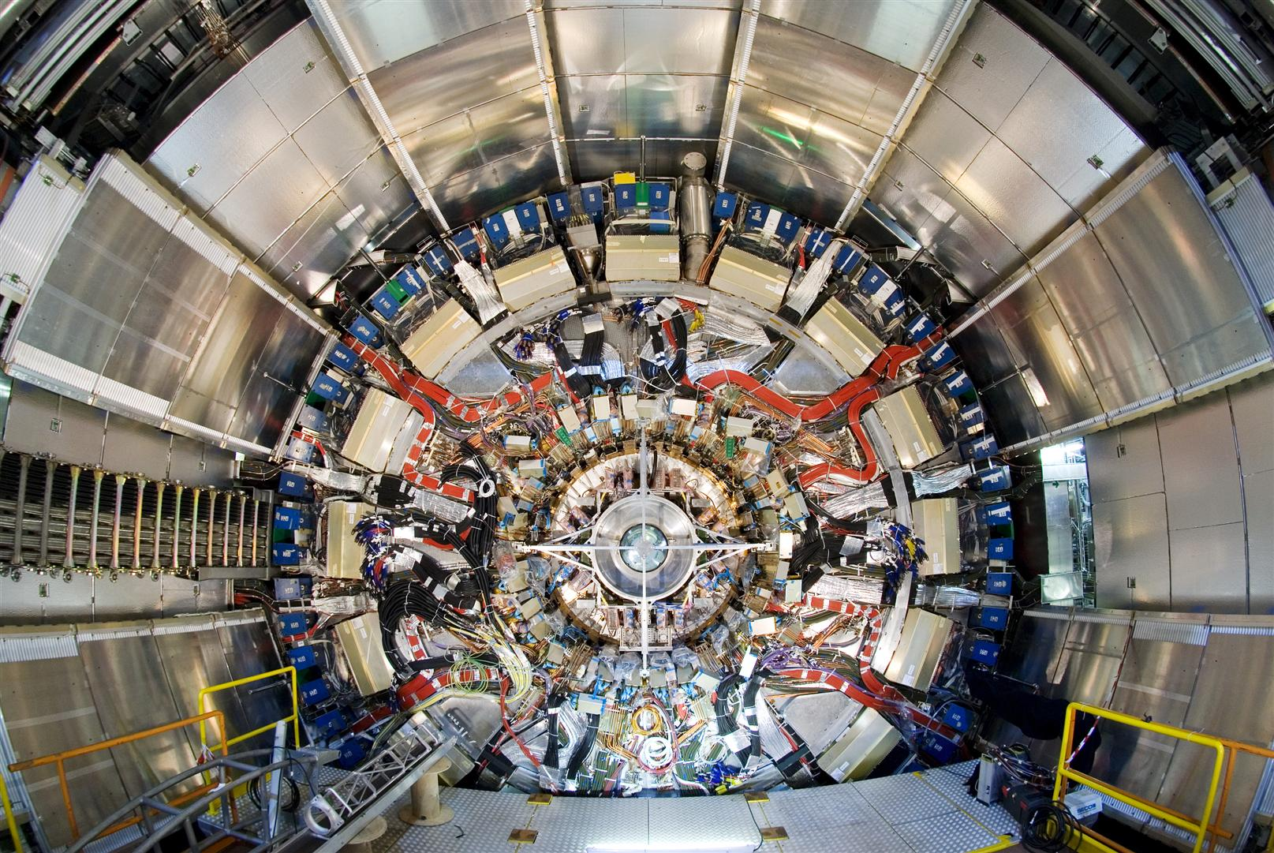
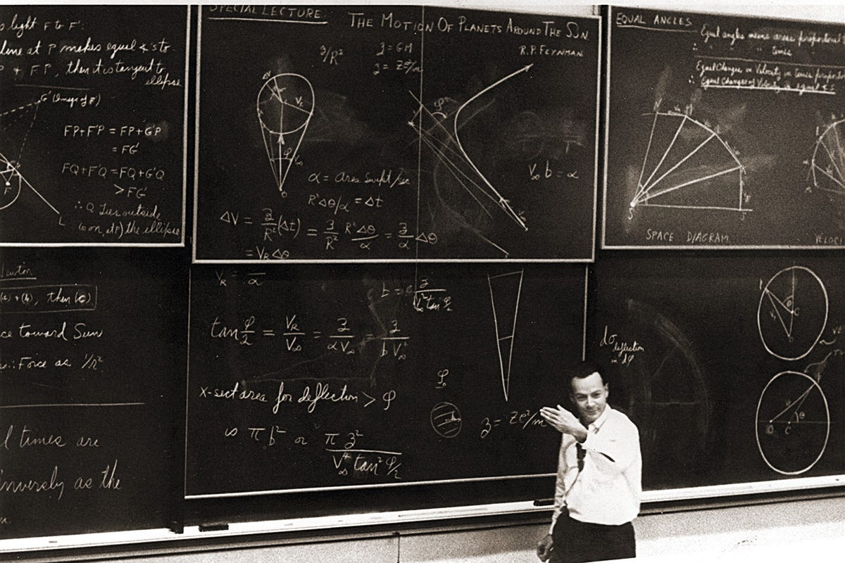
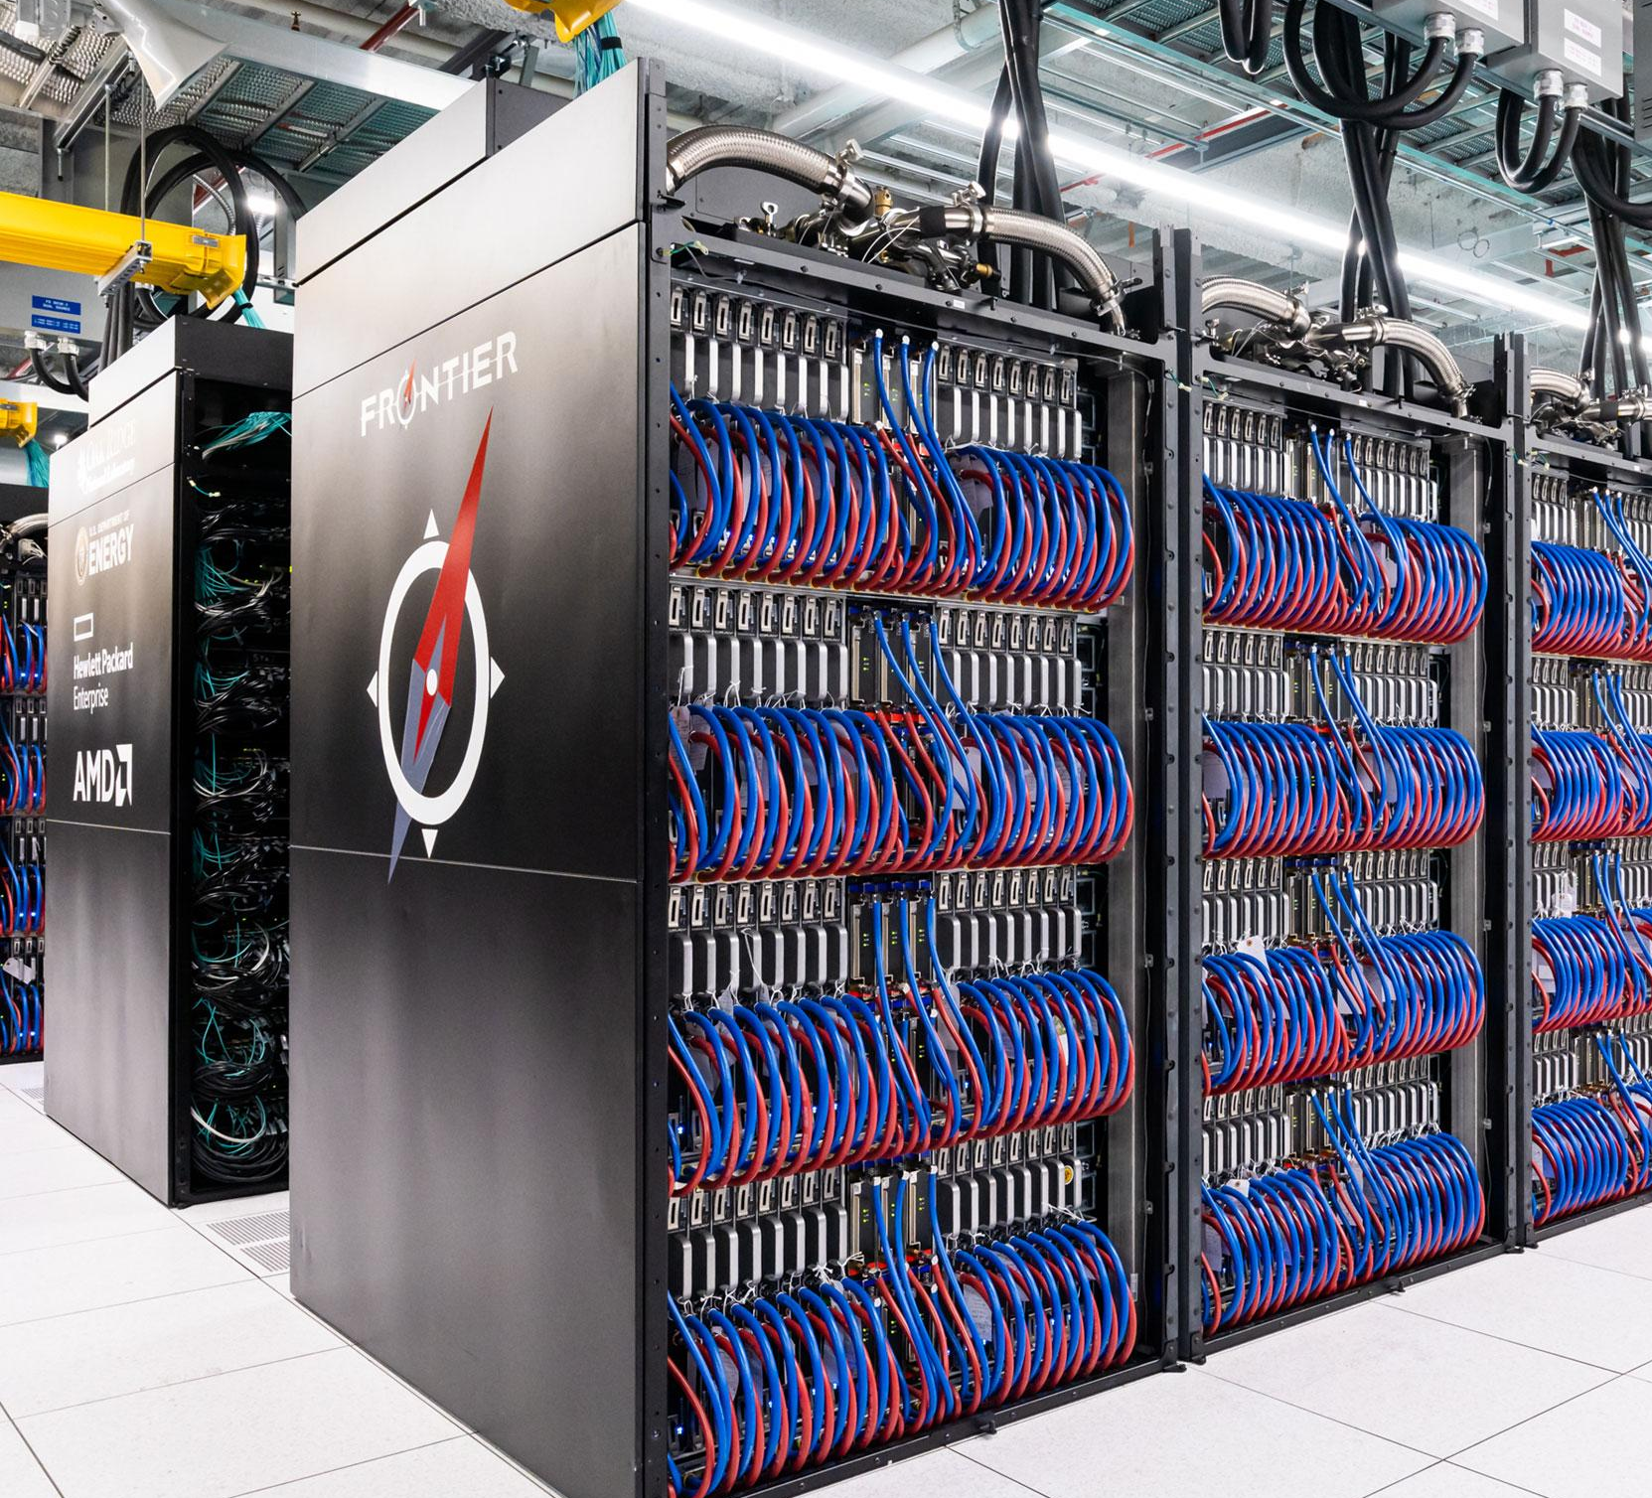
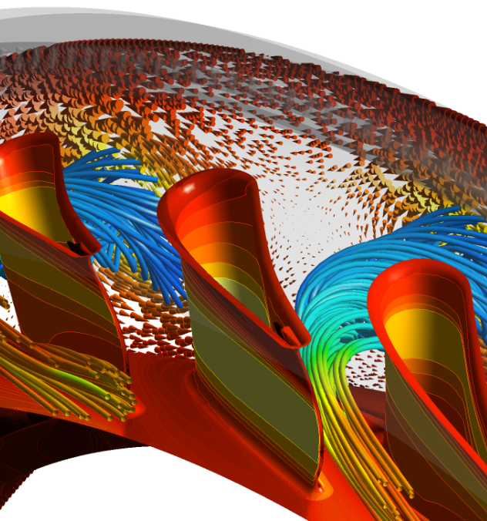
Machine Learning
❤️
Physical Science
Big experimental data
Data obeys laws
Know how to simulate
Historical symbioses with computing

Slide 9
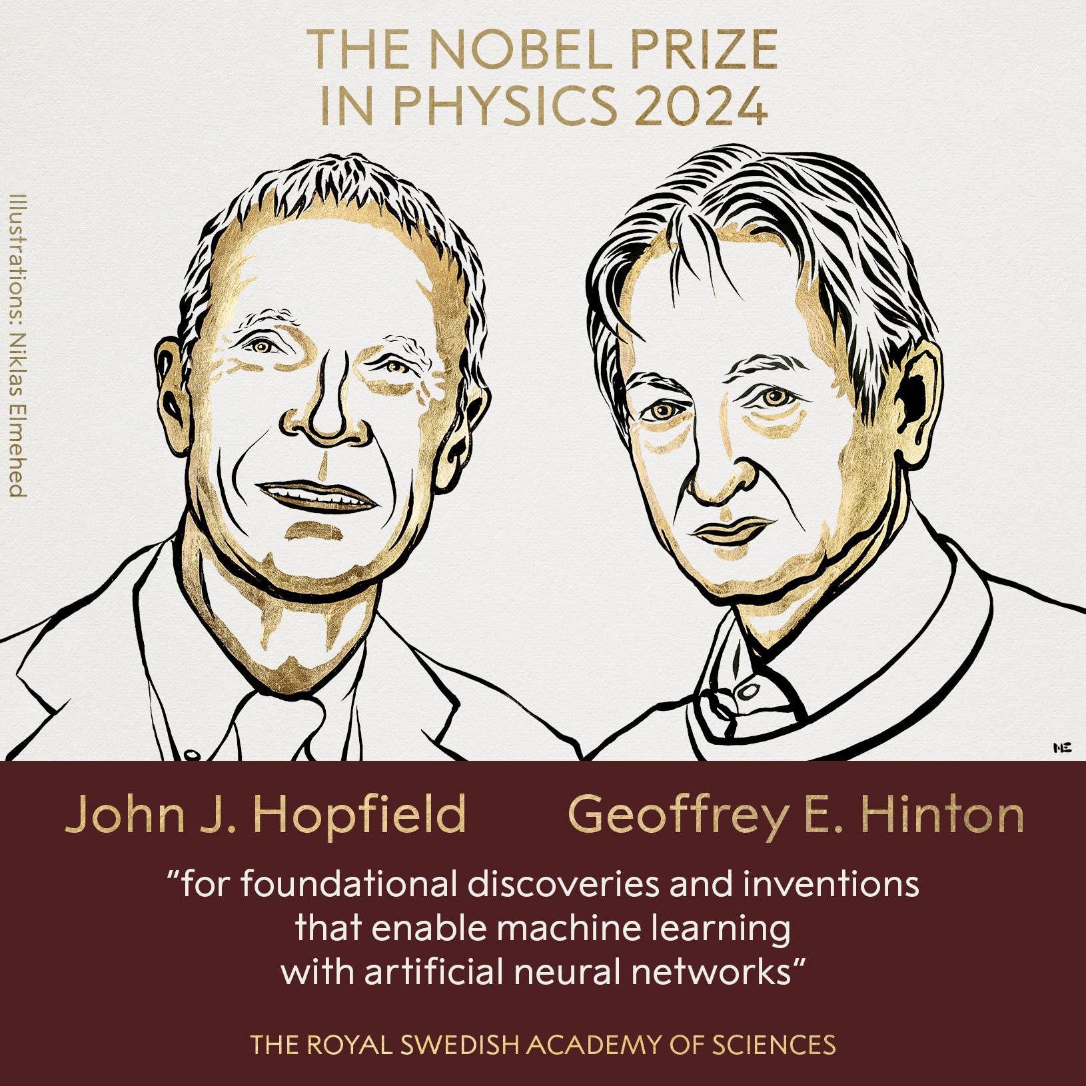
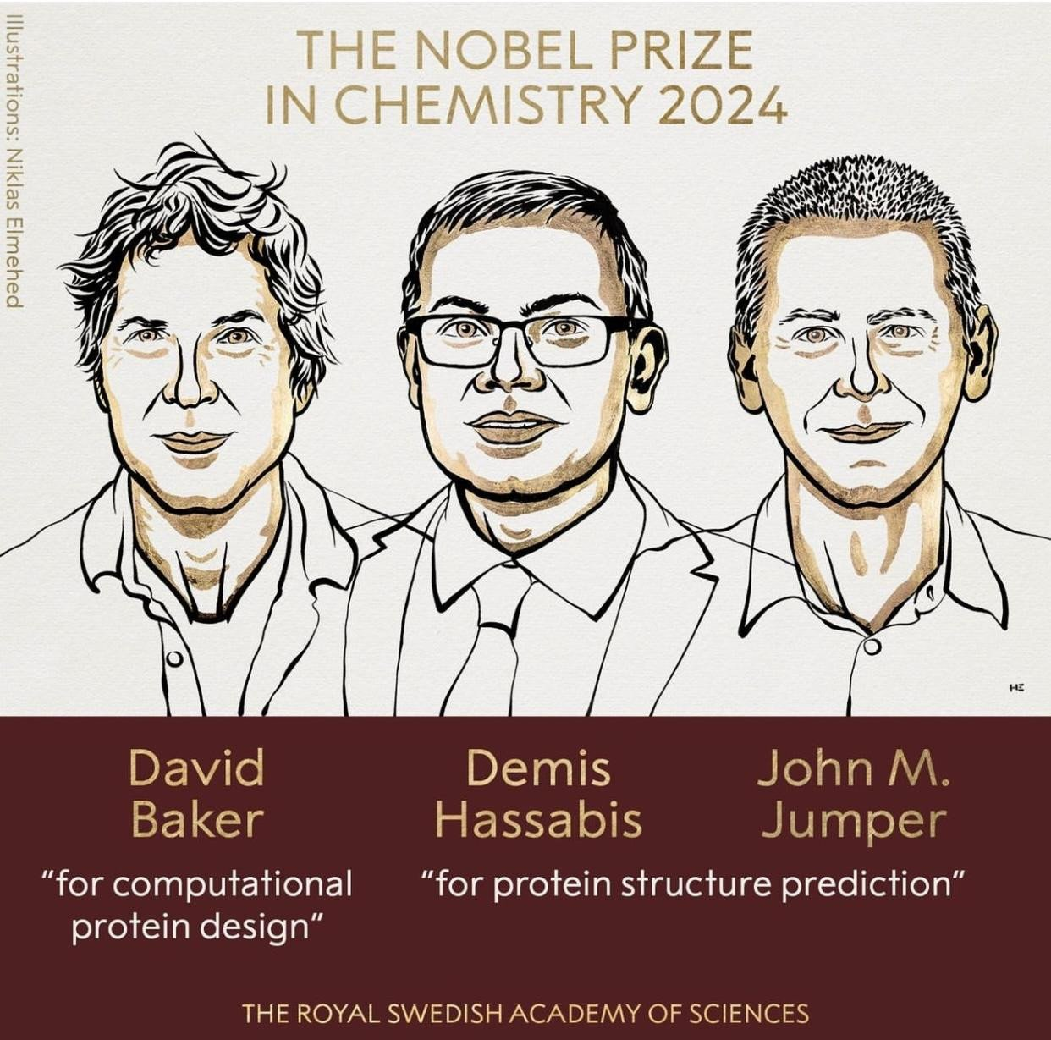

Slide 10
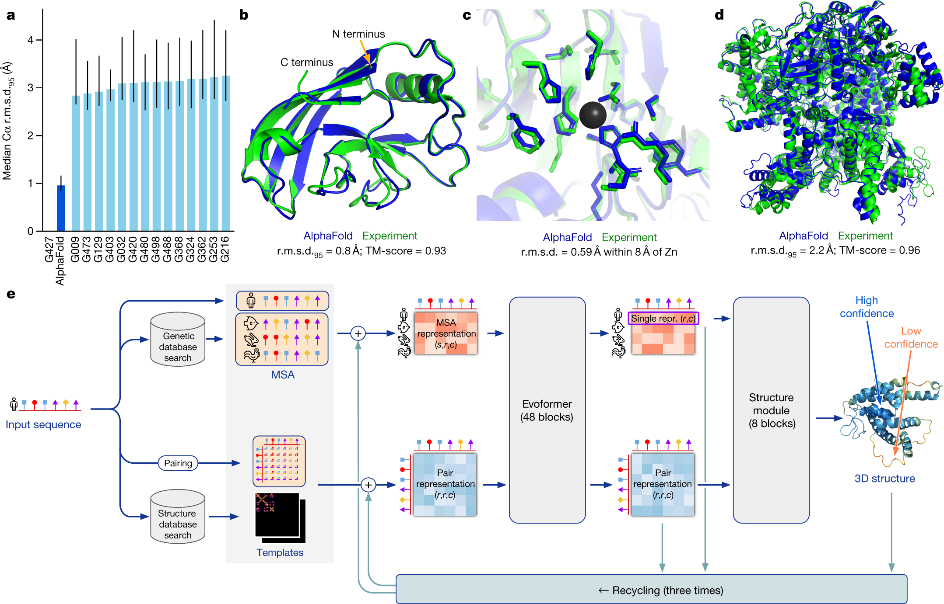
AlphaFold

Slide 11
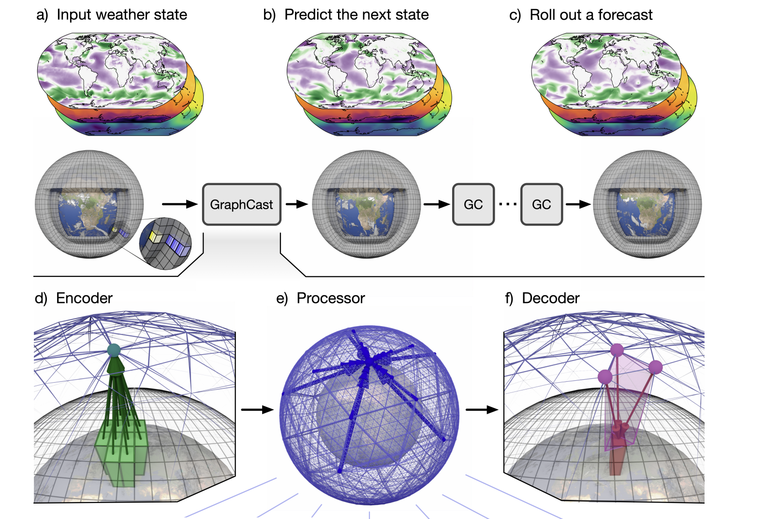
GraphCast

Slide 12
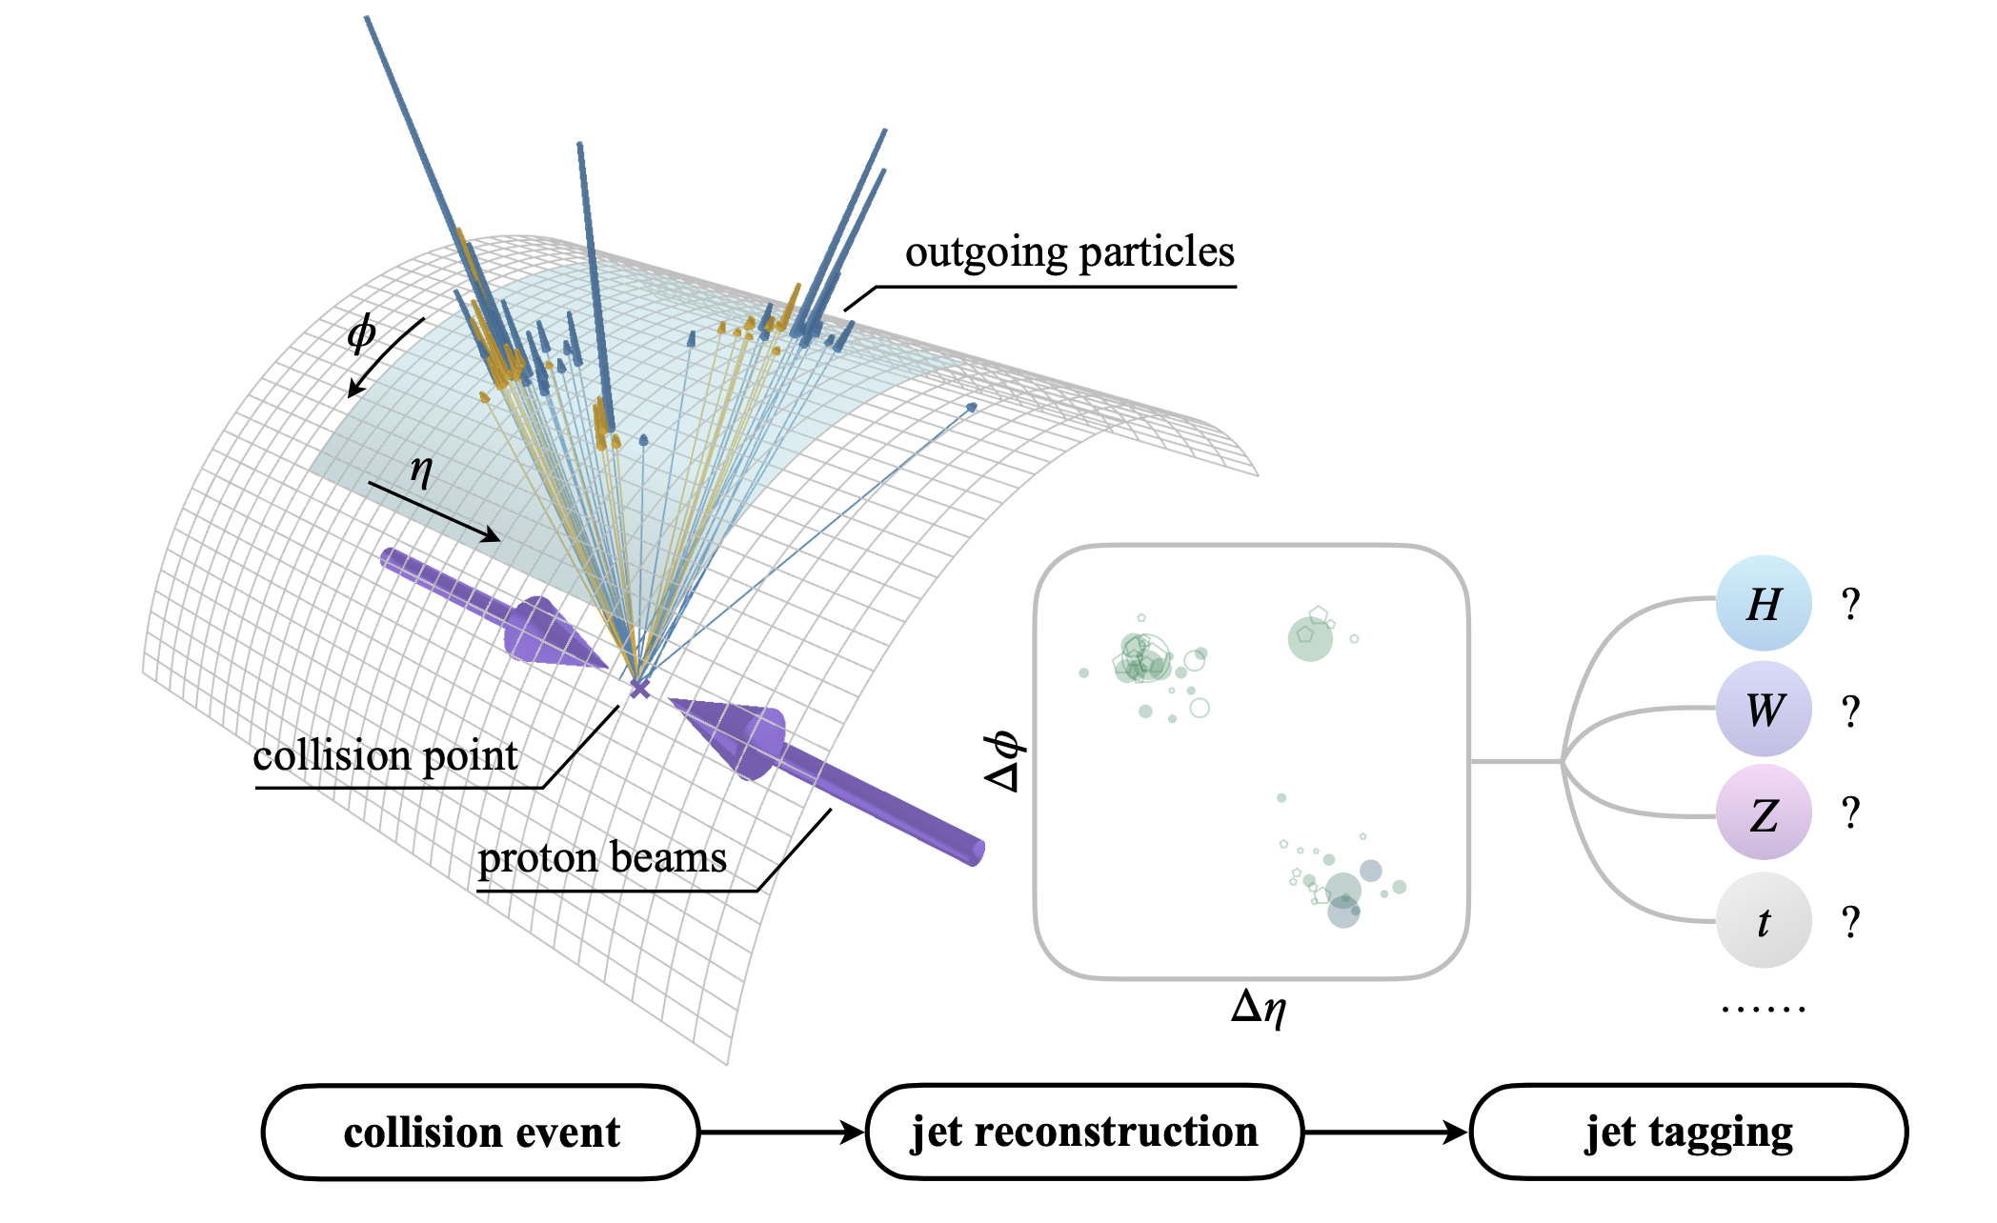
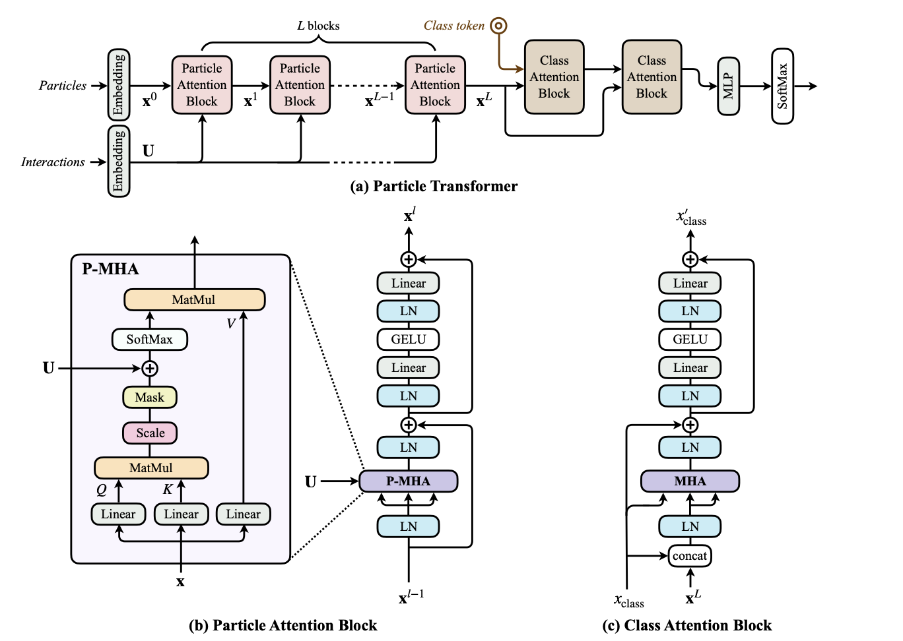
Particle Transformer

Slide 13

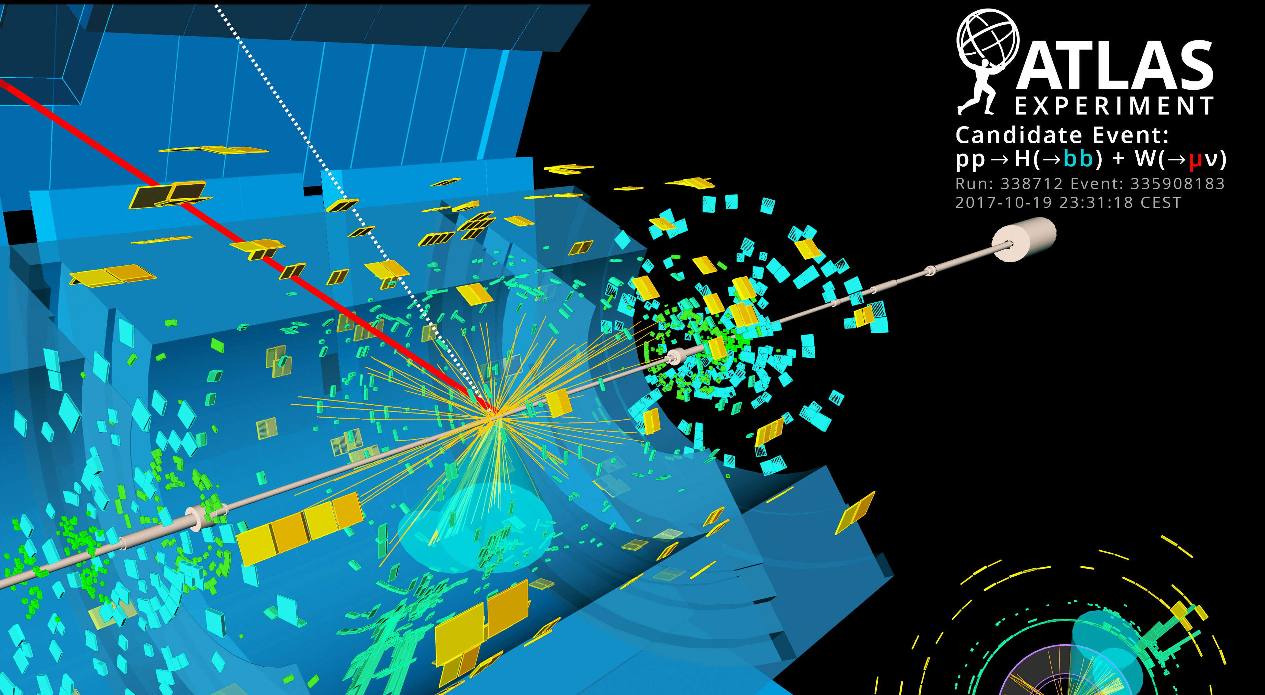
Physical Science Data
Large
Complex
High-dimensional
Highly structured
Physical laws provide constraints and correlations

Slide 14
What do we need to handle this?
Efficient numerical computation software
Optimised computing architecture
Easy-to-use ML frameworks?

Slide 15
GPUs

Slide 16
ML Python Frameworks
Sklearn – simple to use for simple, not so deep problems
Tensorflow – from Google, initially static computation graph, less clear syntax. Keras wrapper for building simple NNs
PyTorch – from Facebook, dynamic computation graph, now more common in research.
Jax – from Google, less oriented towards NNs
We will primarly use PyTorch

Slide 17

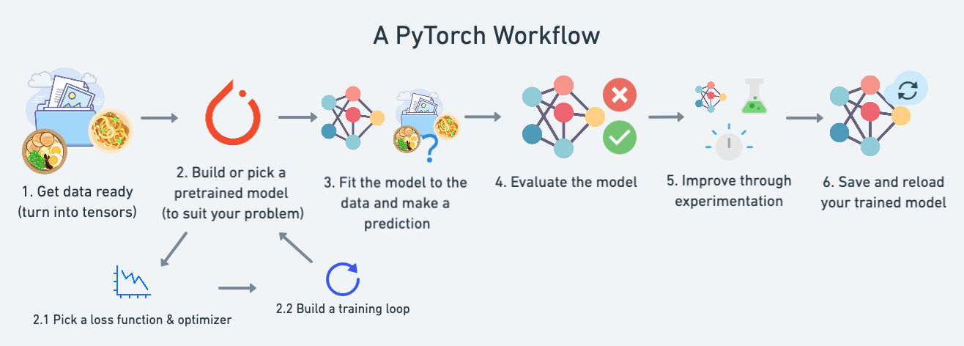
Tensors compatible with GPUs
Autograd for automatic differentiation
Dynamic computation graph

Slide 18
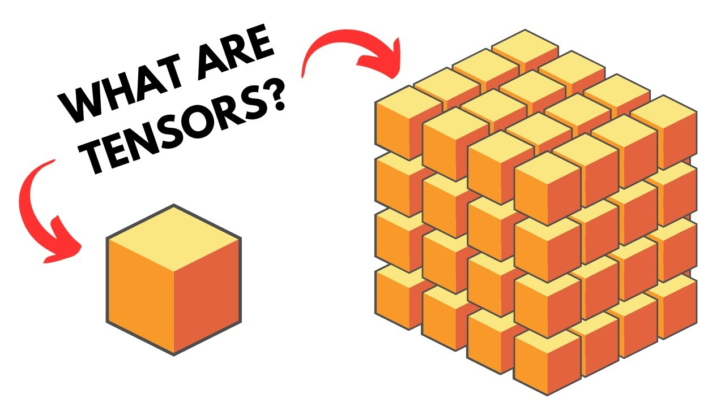
Tensors
Just think “arrays” which can be processed on GPUs…
Parallelised operations – no for loops here

Slide 19
Practical Activity #1
Designed to introduce PyTorch and working with tensors
This should take 20 minutes

Slide 20
Data Requirements
Many examples
Correlated features
Quality
Diversity
Balance

Slide 21
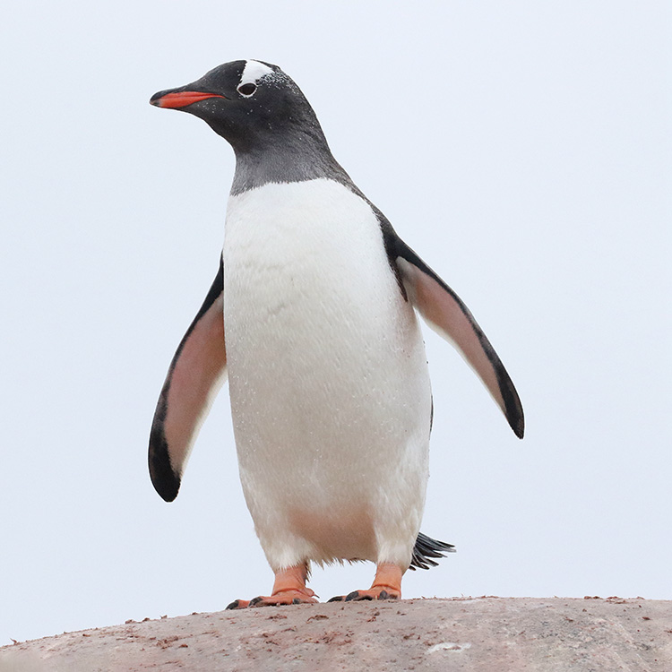
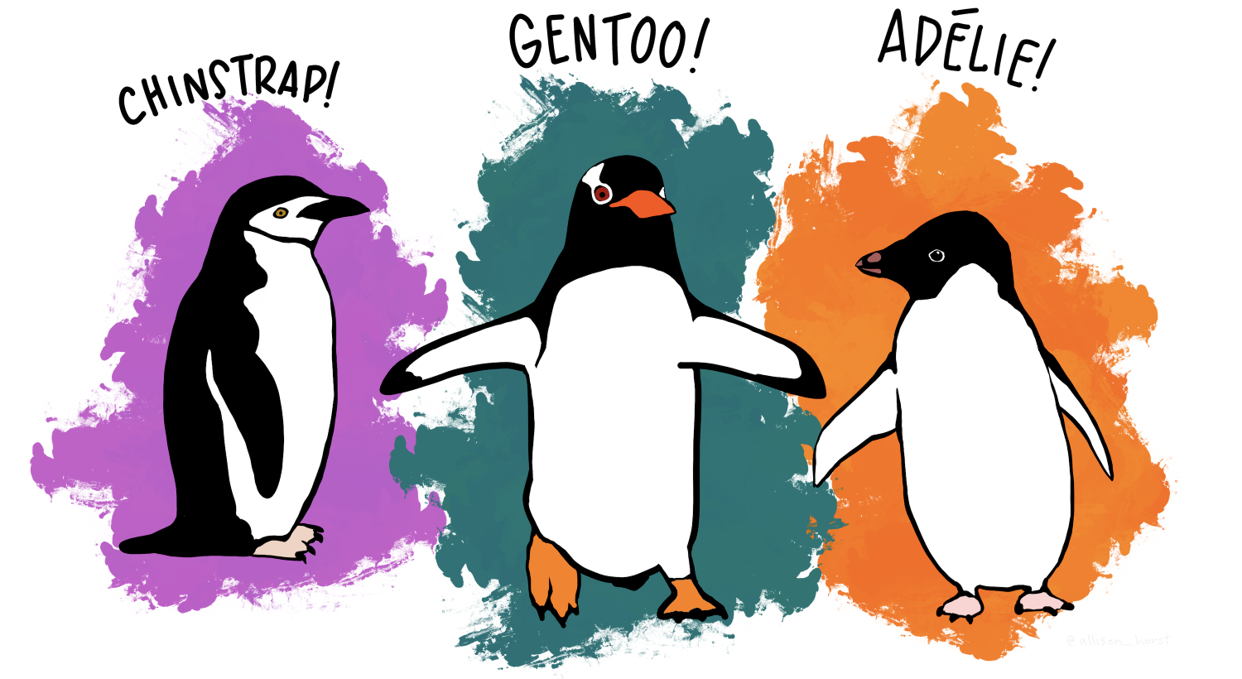
Example dataset

Slide 22
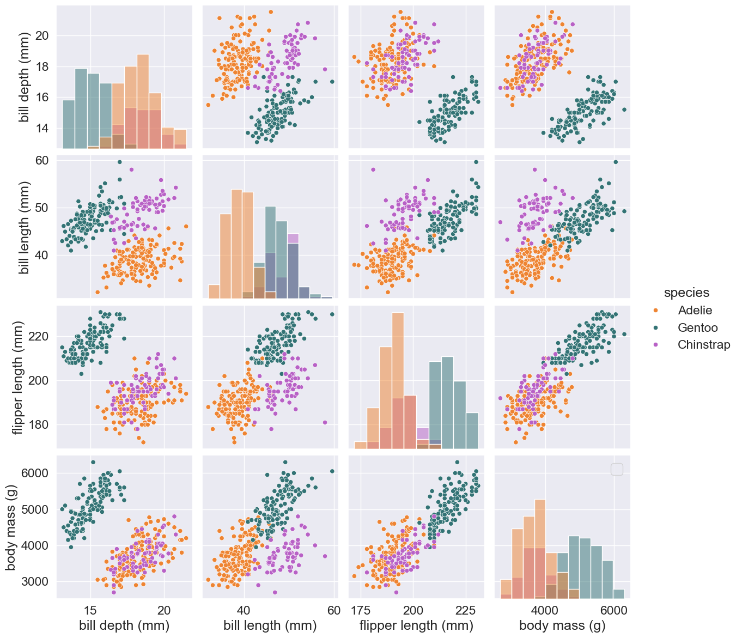

Slide 23
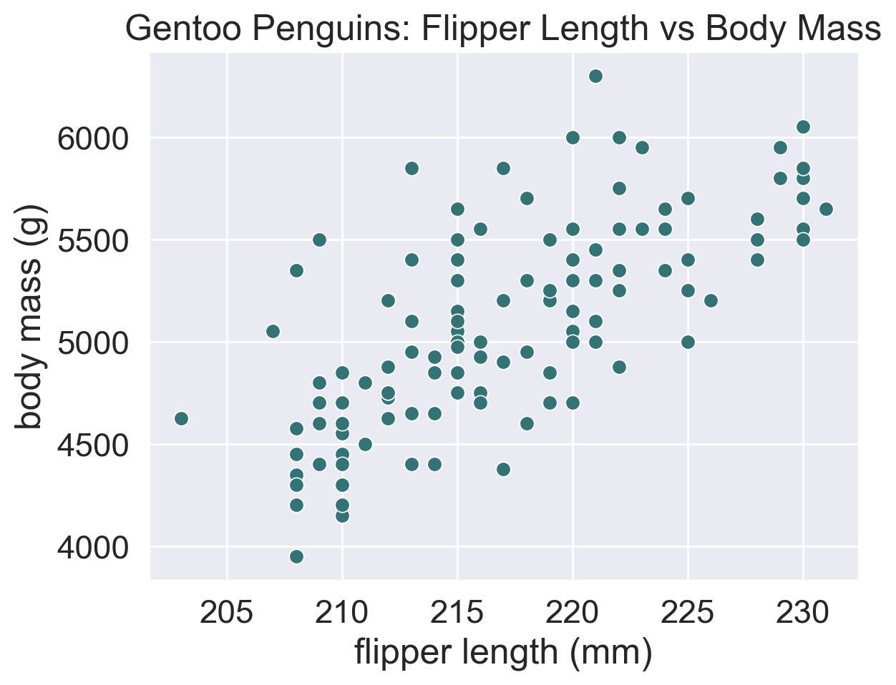

Slide 24
Regression
Predicting numerical data
How heavy is a penguin with this length of flipper?
The outputs are continuous

Slide 25
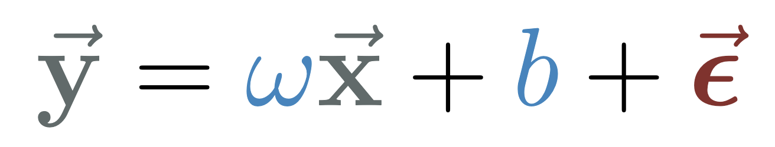
Linear Regression
A simple type of regression we will use
Vector of target data
Vector of input data
Vector of errors
Parameters to find (learn)

Slide 26
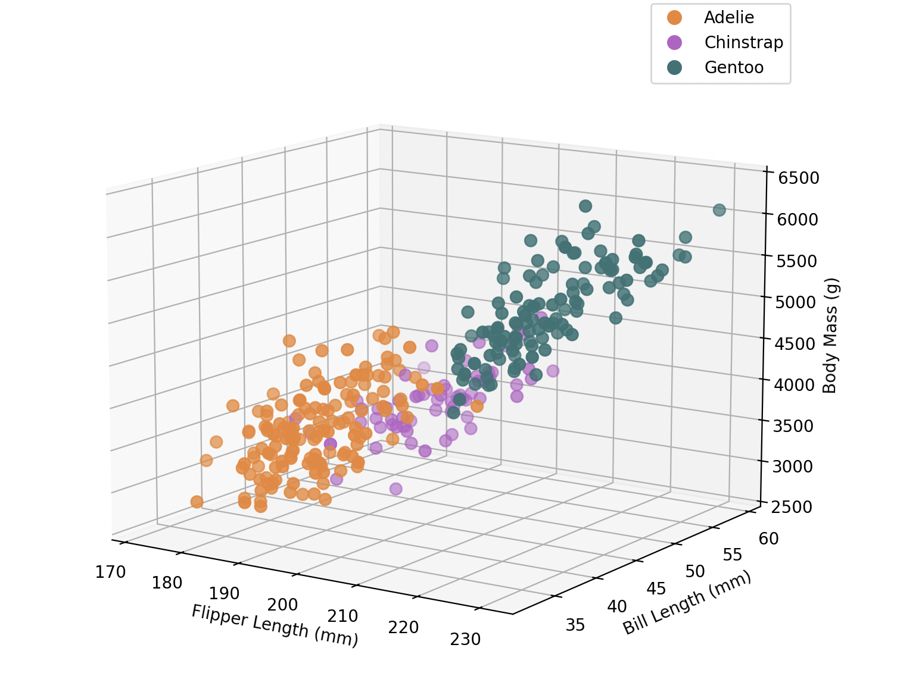
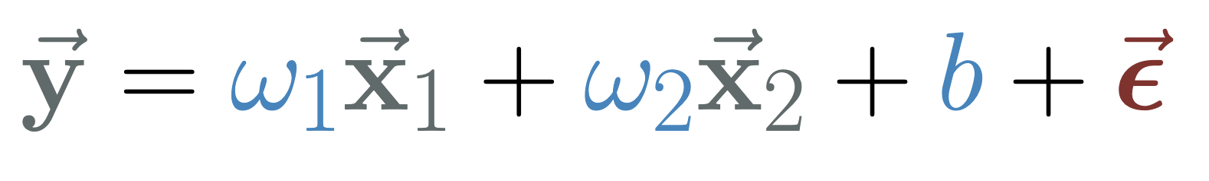
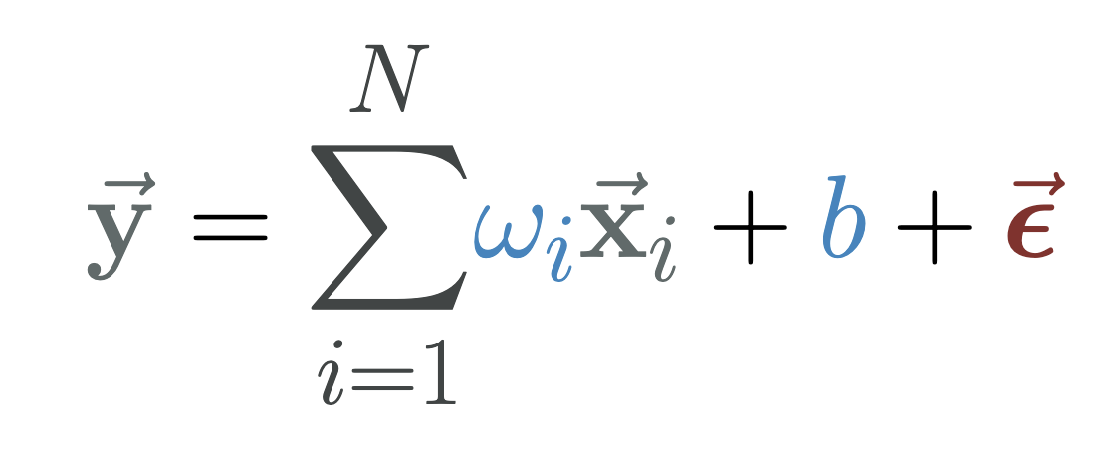
Multiple Linear Regression
Multiple inputs regress a single output
For N inputs:

Slide 27
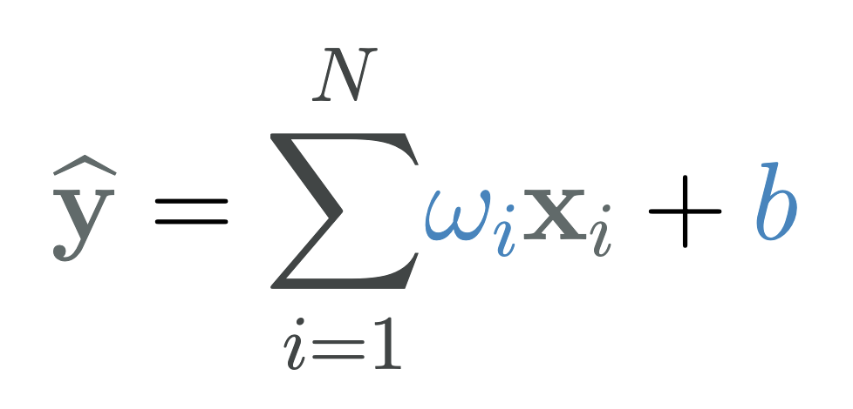
Linear Regression Analytic Solution
Optional slide

Slide 28
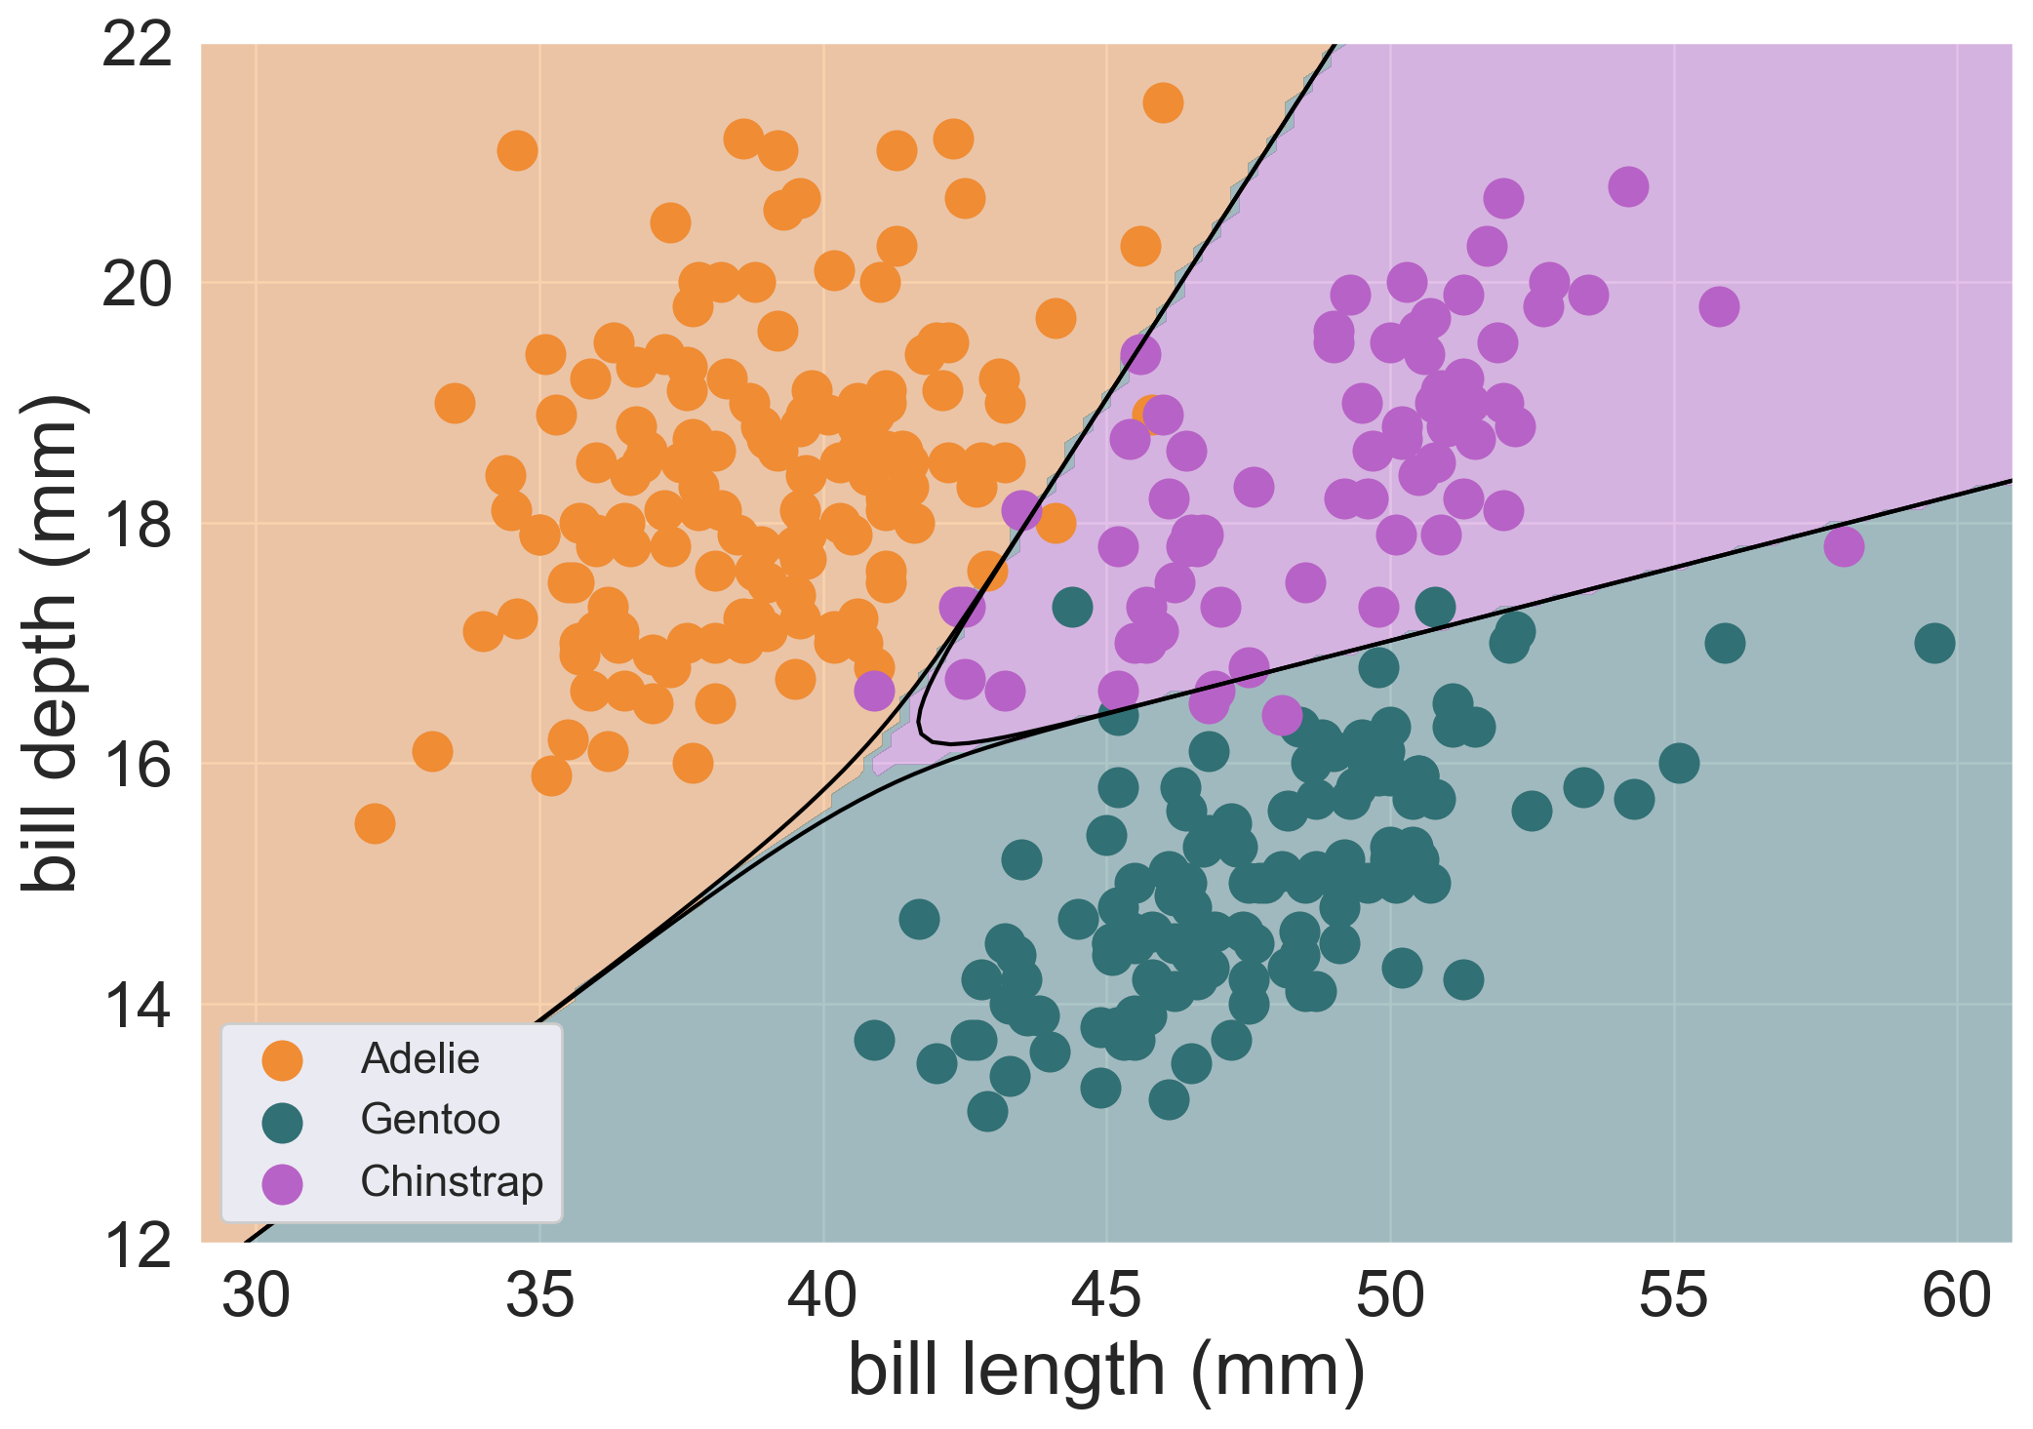
Classification
Predicting categorical data
Given these features, what species of penguin is this?

Slide 29
Classification
Predicting categorical data
Given these features, what species of penguin is this?

Slide 30
Task 2
Using scikit-learn to
Predict the

Slide 31
Things to think about
How to evaluate the model

Slide 32
Practical #2: Scikit-Learn for ML
Load the data and visualize it
Normalise the data
Perform simple linear regression using Scikit-learn
Perform multiple linear regression using Scikit-learn
Visualise the results
Perform ternary classification use Scikit-learn
Visualise the results

Slide 33
Comments
How do we visualize?

Slide 34
Summary
Scikit-learn solves these problems analytically, but we will now solve them using PyTorch in a machine learning way
This will serve as a pre-cursor to DNNs

Slide 35
Basic Supervised Learning Structure
Make a prediction with a model
Check how good the prediction is
Update the model intelligently
A computational model: takes data, outputs prediction
Objective function: compare prediction to truth
Training strategy: how to change model parameters to improve performance?

Slide 36
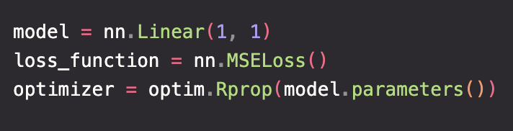
ML Structure
Model makes prediction
Compare prediction to target
Update the model intelligently

Slide 37
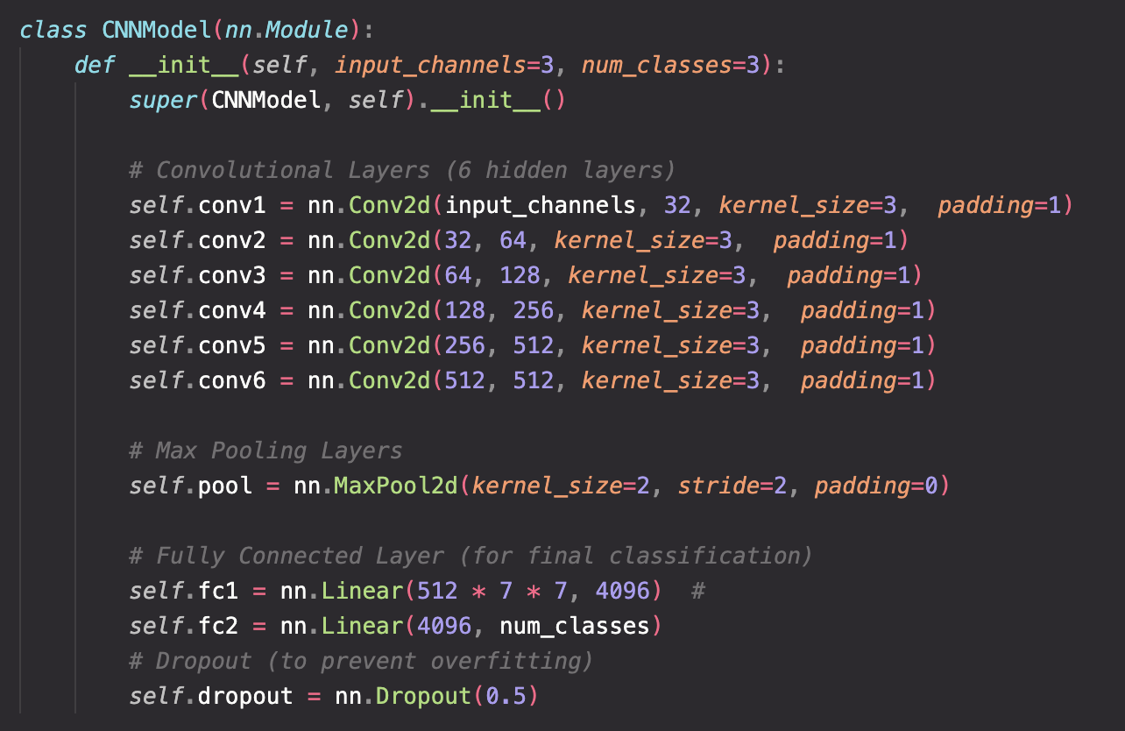
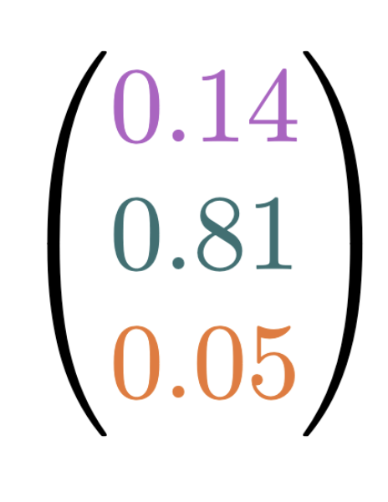
Model
Maps inputs to outputs
A specific architecture performs a specific set of mathematical operations

Slide 38
Linear Models
The prediction depends linearly on the parameters
In ML contexts, the parameters are learnable: refined over learning epochs
All the linear models in Scikit-learn: https://scikit-learn.org/stable/modules/linear_model.html#linear-models
https://en.wikipedia.org/wiki/Linear_predictor_function

Slide 39





Linear Models
x1
x2
$$\text{Σ}$$
+b
y
x3
x4

Slide 40

Objective Function
Objective function / loss function / cost function / error function
How good is my model? Compare prediction to truth
Model 1
Model 2

Slide 41
Inputs
Model 1
Model 2
Target
Outputs
Prediction 1
Prediction 2

Slide 42
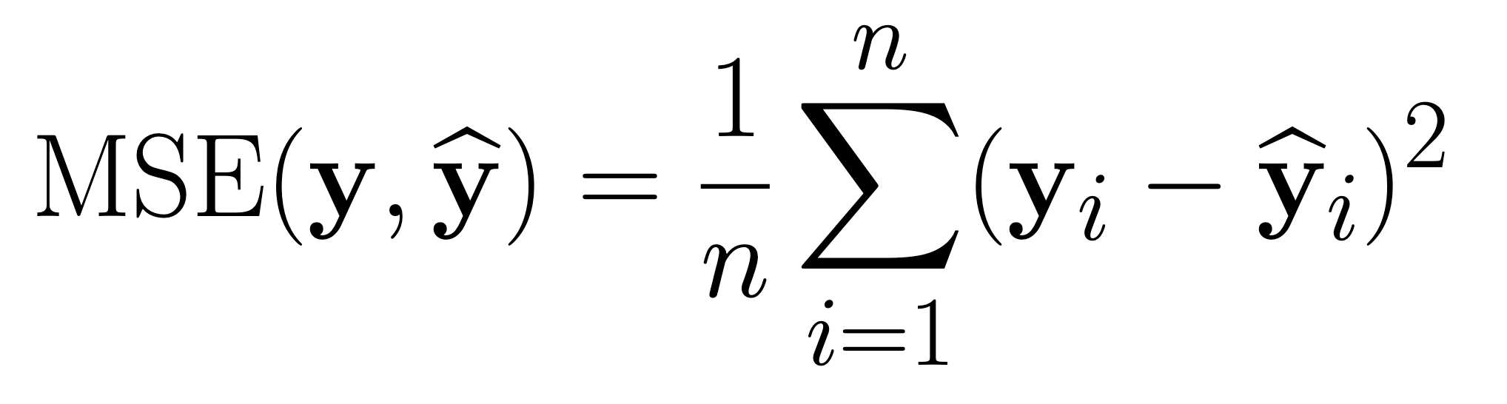
Objective Function
How close is my model’s prediction to the target?
Outputs
Model 1 prediction
Target
Model 2 prediction
Function quantifies “closeness” of prediction and target
Average squared difference between target and predicted data points

Slide 43

Optimisers
The optimisation of an objective function is a very general problem across much of applied mathematics (so not exclusive to ML) e.g. travelling salesman problem.
Improve the model based on its current and past performance.
Involve searching the model parameter space for a better set of parameters. Many ways to achieve

Slide 44
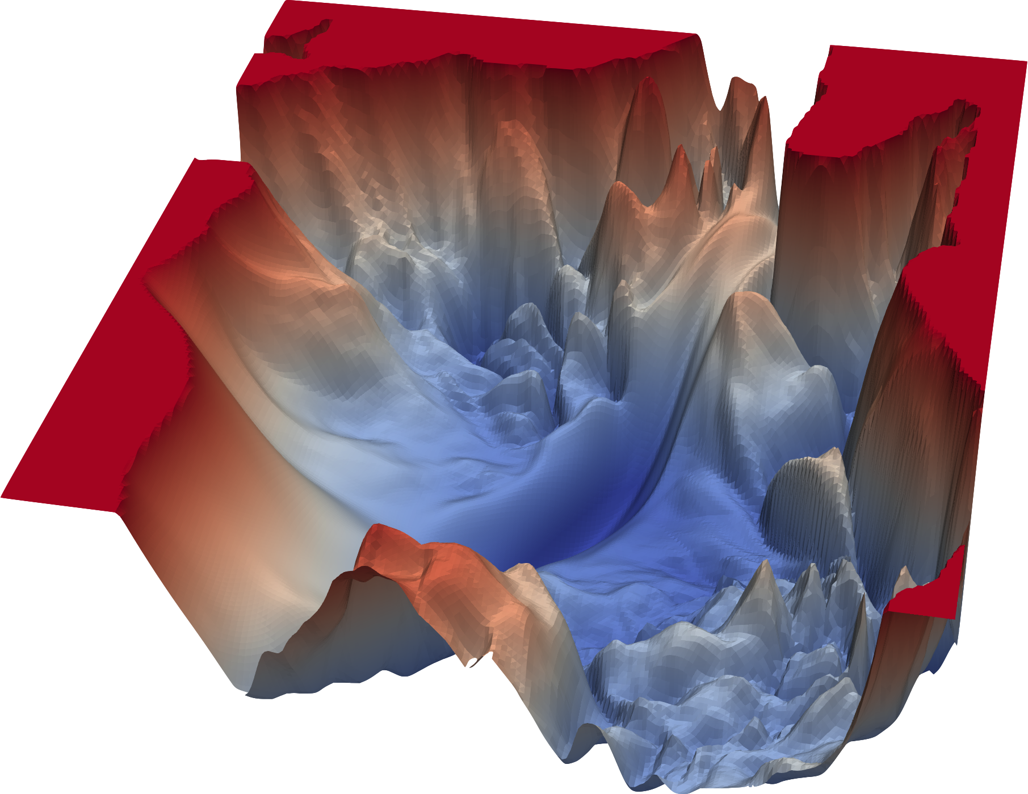
Gradient Descent
For iteratively finding a minima…
Compute the gradient where you are
Move in the direction of steepest descent
Challenges:
Computing the gradient when there’s many parameters
Knowing how big a step to take
Knowing you’re at the global minima
Other optimisers exist but just used gradient descent…

Slide 45
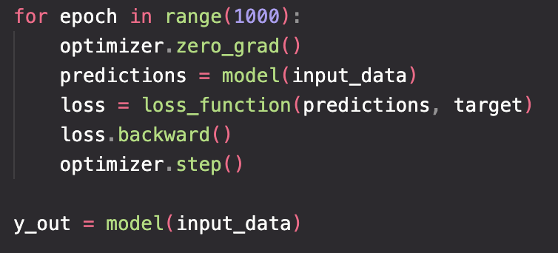
Linear Regression Example
Definitions
Training loop

Slide 46
Sigmoid

Slide 47
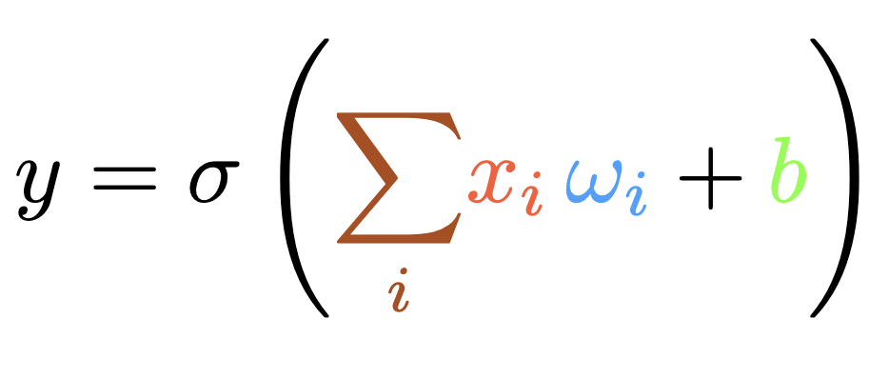


Perceptron
x0
x1
$$\text{Σ}$$
+b
$$σ$$
y
x2
x3

Slide 48
Perceptron
x0
x1
y
Contains a weighted sum of the input nodes, possible addition by a bias term, and then evaluation with an activation funciton
x2
x3

Slide 49

Perceptron
x0
b
x1
$$\text{Σ}$$
$$σ$$
y
x2
x3

Slide 50
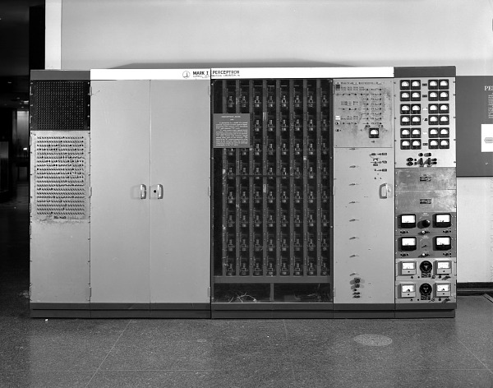
Perceptron

Slide 51
Practical #3: PyTorch for ML
Follow the tutorial on building a simple regressor in PyTorch
Extend this to either a multi linear regressor, or a classifier
Feel free to use the Iris dataset if you prefer!

Slide 52
Classification
Take the regression practice and throw a softmax on the end
So far we have dealt with linear models, which cannot model most real world cases
One of the magic ingredients of neural networks are activation functions…

Slide 53
Practical 3
Logistic regression

Slide 54
Practical 3 Code + Answers

Slide 55
Summary so far – should have taken 2 hours up to this point
We have looked at two different ML problems: regression and classification
We have used non-deep techniques, amenable because our datasets were small and low-dimensional
We defined feed-forward models to make predictions
We used appropriate loss functions to evaluate the model’s performance
We used PyTorch’s automatic tools for computing the gradient and updating the learning paramters
A linear layer plus a sigmoid function gave a non-linear response

Slide 56
Neural Networks
We have all the building blocks. Neural networks aren’t more complicated, they’re just deeper…

Slide 57
Neural Networks
Focusing in on the perceptron model. Neural networks expand this to have multiple inputs and multiple outputs. We call this a layer. Then stack multiple layers in series. This stacking defines a multi-layer perceptron i.e. a deep neural network.

Slide 58
Activation Functions
Maybe leave this for Maximillian?
Compare ReLU, arctanh, sigmoid

Slide 59
PyTorch implementation

Slide 60
Backpropagation
Is one part of the optimizer (but not all of it)
An efficient application of the chain rule, relying on dynamic programming

Slide 62
Show the benefits…

Slide 63
Universal Approximation Theorem
Universal Approximation Theorem

Slide 64
More about backpropagation
I should probably cover this
We have a composition of functions, thus we can apply the chain rule
The efficient computation of the gradients is what is highly optimized in modern ML packages

Slide 65
More about optimisers?
This can maybe be left for Maximillian

Slide 66
Example
Penguin classification with PyTorch NN

Slide 67
Things I haven’t said
How does backpropagation work?
What other choices do I have for loss functions?
How do optimizers work and which is best?
What if my data has some inherent structure I can utilize?
Optimizing hyperparameters
Reducing overfitting

Slide 68
Challenges (45 minutes)
House price regression
LHC data events binary classification

Slide 69
Mini Challenge #1
Build a simple NN classifier to distinguish between H → 4l and the ZZ → 4l channel
If you don’t care about particle physics, treat this as a generic classification problem
Tasks:
Load data
Split into training/validation/testing sets
Build a NN
Build a training function
Train
Visualise output

Slide 70
Mini Challenge #2
House price regression

Slide 71
Particle Physics in a slide
Underneath Geneva, we collide protons in the Large Hadron Collider, and record the collision data using dedicated experimental detectors.
This gives us enormous, highly structured data sets which are a rich playing field for machine learning.
Example: the observation of the Higgs boson was made in 2012, in part through the process of Higgs bosons decaying to 4 leptons which were then recorded in the ATLAS and CMS detectors. We can mimic part of this analysis by training a NN classifier to

Slide 72
